Slide 1
Topic 9 – Text Modelling
Statistics and Data Analysis
COR1-GB.1305
Prof: Chris Volinsky
NYU Stern: Fall 2023

Slide 2
In this chapter
Intro to Text
Also referred to as Natural Language Processing or NLP
Unstructured data!
Modelling Text with Naïve Bayes
Taste of text analytics…
DSB: Chapter 10
Shmueli: Chapter 20
Python: Natural Language Toolkit
import nltk
import spacy

Slide 3

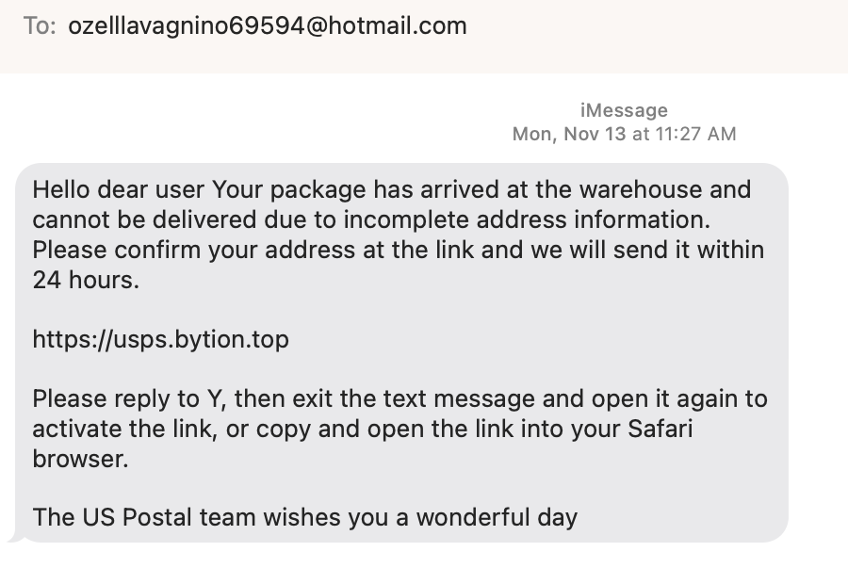
Motivating example: Spam
Recently in my email:
Recently in my texts:
Notes:
Ask them how they think we can detect this as spam

Slide 4
Spam detection
What is the business problem?
What is the data science problem?
What are the costs/benefits?
How would you catch this?
What action would you take?
How would you set a threshold?
Notes:
Ask them how they would catch it?
How sure do you need to be?

Slide 5
Text is everywhere
Email
Texts
News articles
Online reviews
Customer feedback
Tweets
Social media comments

Slide 6
Overview of Text Mining
Automatically extracting meaning from a document
Label a document into one of many known types
E.g. Library categorization
Multi-class classification
Clustering documents into useful groups
Unsupervised learning
Query a set of documents for search or to find most similar ones
E.g. legal precedent, patent searches
Text-based learning often requires a large collection of documents to learn from – a corpus - that needs to be pre-processed significantly before analysis.

Slide 7
Text Analysis is Hard!
“Boston beat San Francisco in the game last night” vs “San Francisco beat Boston in the game last night”
“Hitchcock shot The Birds in Bodega Bay”
“Lets eat, Grandma!”
“I can’t recommend this person highly enough”
Text is more than just words, and understanding language (NLP) is a technical field all to itself…but we have to start somewhere!

Slide 8
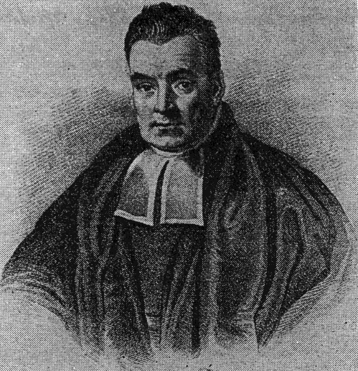
Naïve Bayes: A simple model for text analytics

Slide 9
Recall : Conditional Probability
For any two events A and B:
P(A|B) = P(A AND B) / P (B)
P(A AND B) = P(A|B) x P(B)

Slide 10
Recall : Conditional Probability
For any two events A and B:
P(A|B) = P(A AND B) / P (B)
P(A AND B) = P(A|B) x P(B)
70% of customers at a movie theatre buy drinks. Of those that buy drinks, 30% also buy popcorn. What % of the audience buys drinks and popcorn?
A=drinks
B=popcorn
P(A) = .70
P(B|A) = .30
P(B and A) = P(B|A) x P(A) .7 x .3 = .21 (21%)

Slide 11
Recall : Conditional Probability
For any two events A and B:
P(A|B) = P(A AND B) / P (B)
P(A AND B) = P(A|B) x P(B)
Accept Offer?
 | YES | NO | Totals
Phone Call | 25 | 75 | 100
Text | 125 | 175 | 300
Email | 125 | 475 | 600
Totals | 275 | 725 | 1000
Marketing Channel
What is the probability of acceptance given email channel?

Slide 12
Bayesian Statistics
Thomas Bayes came up with Bayes’ Rule in the 1800s by just turning around the rules of probability
P(A AND B) = P(A|B) x P(B)
P(A AND B) = P(B|A) x P(A)
Then:
P(A|B) = P(B|A) x P(A) / P(B)
Bayes’ Rule
Bayes’ Rule is the foundation of a whole branch of analytics called Bayesian Statistics, well beyond the scope of this class
Bayesian Networks
Hidden Markov Models
Markov Random Fields
Notes:
Bayesians have priors…

Slide 13
Why Bayesian?
Why is this one equation so important?
It allows us to calculate things differently when looking at the evidence (E) for a hypothesis or outcome (H)
Typically in DS (or stats) we are trying to find the probability of some outcome (H) given some data, or evidence (E)
Let’s use the measles example in DSB (p256):
H = measles
E = sympoms (red spots)
We want to calculate P(H|E)
To do this might be hard…we would need to understand all of the reasons someone might have red spots and which of those are measles.
But we can calculate:
P(E|H) – the probability that someone has red spots, given they have measles
P(H) – the overall probability of measles in the population
P(E) - the overall probability (or prevalence) of red spots in the population
So we can now calculate: P(H|E) = P(E|H) x P(H) / P(E)

Slide 14
So What??
Q: So how is this all relevant to data science???
A: The probabilities that are output from our models are conditional probabilities
Customer | Age | Income | No. credit cards | Response
John | 35 | 35K | 3 | Yes
Charlene | 22 | 50K | 2 | No
Rayshawn | 63 | 200K | 1 | No
Ping | 59 | 170K | 1 | No
Nellie | 25 | 40K | 4 | Yes
P(Nellie responds Yes) =
P(Yes | Age=25, Income=40k, credit cards = 4, …)
H : Response = Yes
E : features

Slide 15

Applying Bayes’ Rule in Data Science
P(Nellie responds Yes)
= P(Yes | Age=25, Income=40k, credit cards = 4, …)
= P(Yes | features)
= P(features | Yes) x P(Yes) / P(features)
H : Response = Yes
E : features
posterior
likelihood
x
/
prior
marginal probability
What we want to know
Something we can calculate ??
Something we can calculate or estimate
Might be hard to calculate
may be hard – you may never see the same set of features twice!
One weird trick: If we want to estimate Nellie’s most likely response, it is the same as comparing the P(Nellie responds Yes) vs P(Nellie responds No). Since both have the same marginal probability in the denominator, we don’t have to calculate it!!

Slide 16
Applying Bayes’ Rule in Data Science
Now we have reduced the problem to calculating:
P(Yes | features) = P(features | Yes) x P(Yes) / P(features)
And we are going to make an assumption – a naïve assumption – that the features are conditionally independent:
P(features | Yes) = P(f₁|Yes) x P(f₂|Yes) x … x P(f_{k}|Yes)
These can usually be calculated directly from training data
That is, we might not have anyone else who has exactly the same features as Nellie, but we probably have people who have the individual traits
This is the basis of the Naïve Bayes Classifier

Slide 17
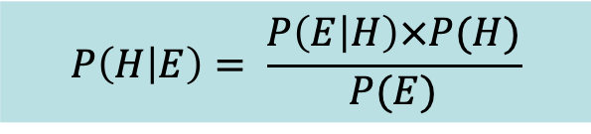
So, lets get back to text!!
Text | Spam
a l c | 1
b c d | 0
c e k | 1
a c d | 1
c f g | 1
a c d | 0
a b c | 1
b d f | 0
New Case to classify:
“a b d”
P(Spam=1| “a b d”) ?
$$P\left(H | E\right)= \frac{P\left(E | H\right)×P(H)}{P(E)}$$
Notes:
note complications with new case – values not present in training data

Slide 18
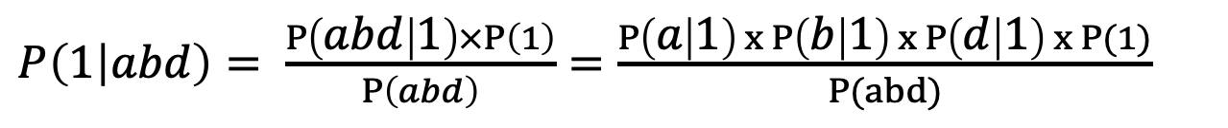
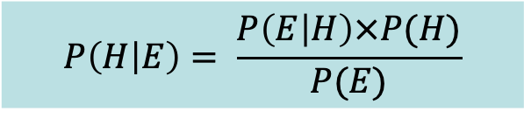
Bayes’ Rule
$$P\left(H | E\right)= \frac{P\left(E | H\right)×P(H)}{P(E)}$$
P( abd | Spam=1) x P(Spam=1)
P(Spam = 1 | abd ) =
P(abd )
Text | Spam
a l c | 1
b c d | 0
c e k | 1
a c d | 1
c f g | 1
a c d | 0
a b c | 1
b d f | 0
Problem: we have never seen ‘a-b-d’
But: we have seen ’a’, ‘b’, ‘d’ …
conditional independence
$P\left(1 | abd\right)= \frac{P\left(abd | 1\right)×P\left(1\right)}{P\left(abd\right)}=\frac{P\left(a | 1\right) x P\left(b | 1\right) x P\left(d | 1\right) x P(1)}{P(abd)}$

Slide 19
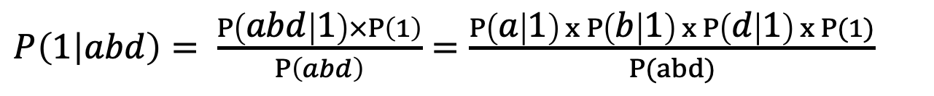
Naïve Bayes
$P\left(1 | abd\right)= \frac{P\left(abd | 1\right)×P\left(1\right)}{P\left(abd\right)}=\frac{P\left(a | 1\right) x P\left(b | 1\right) x P\left(d | 1\right) x P(1)}{P(abd)}$
P(a|1)? P(b|1)?
Can all be calculated directly from the data!
P(a|1) = 3/5
P(b|1) = 1/5
P(d|1) = 1/5
P(1) = 5/8
Text | Spam
a l c | 1
b c d | 0
c e k | 1
a c d | 1
c f g | 1
a c d | 0
a b c | 1
b d f | 0

Slide 20
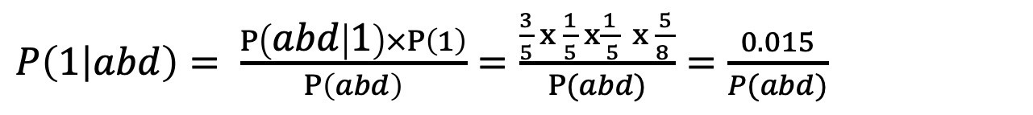
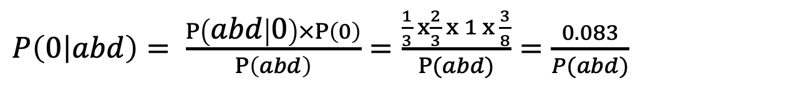
So, what is probability of Spam=1?
Text | Spam
a l c | 1
b c d | 0
c e k | 1
a c d | 1
c f g | 1
a c d | 0
a b c | 1
b d f | 0
$P\left(1 | abd\right)= \frac{P\left(abd | 1\right)×P\left(1\right)}{P\left(abd\right)}=\frac{\frac{3}{5} x \frac{1}{5} x\frac{1}{ 5} x \frac{5}{8 }}{P(abd)}=\frac{0.015}{P(abd)}$
$P\left(0 | abd\right)= \frac{P\left(abd | 0\right)×P\left(0\right)}{P\left(abd\right)}=\frac{\frac{1}{3} x\frac{2}{3} x 1 x \frac{3}{8}}{P(abd)}=\frac{0.083}{P(abd)}$
What is the final probability estimate?
p(Spam=1|a b d)=0.015 / (0.015 + 0.083) = .153 = 15.3%
Note: beware of zero probabilities…
You can do a ”Laplace correction” here if needed
sklearn.naive_bayes.BernoulliNB(alpha=1)
Notes:
Two important things here:
- The “conditional flip” plus the “conditional independence” are the two things that make this work.

Slide 21
Why Naïve Bayes for text??
The conditional independence probability is very useful for text
We have probably never seen that specific collection of words before
BUT we have seen each word independently in both scenarios
The individual probabilities are very easy to calculate
Just counting when they occur
Naïve Bayes can be used for any predictive problem!
BUT the features have to all be nominal categorical (like words!)
If you have numerics, you can run NB by binning them
But you lose the ordering…have to treat them like nominal…
Discussion: DSB p261

Slide 22
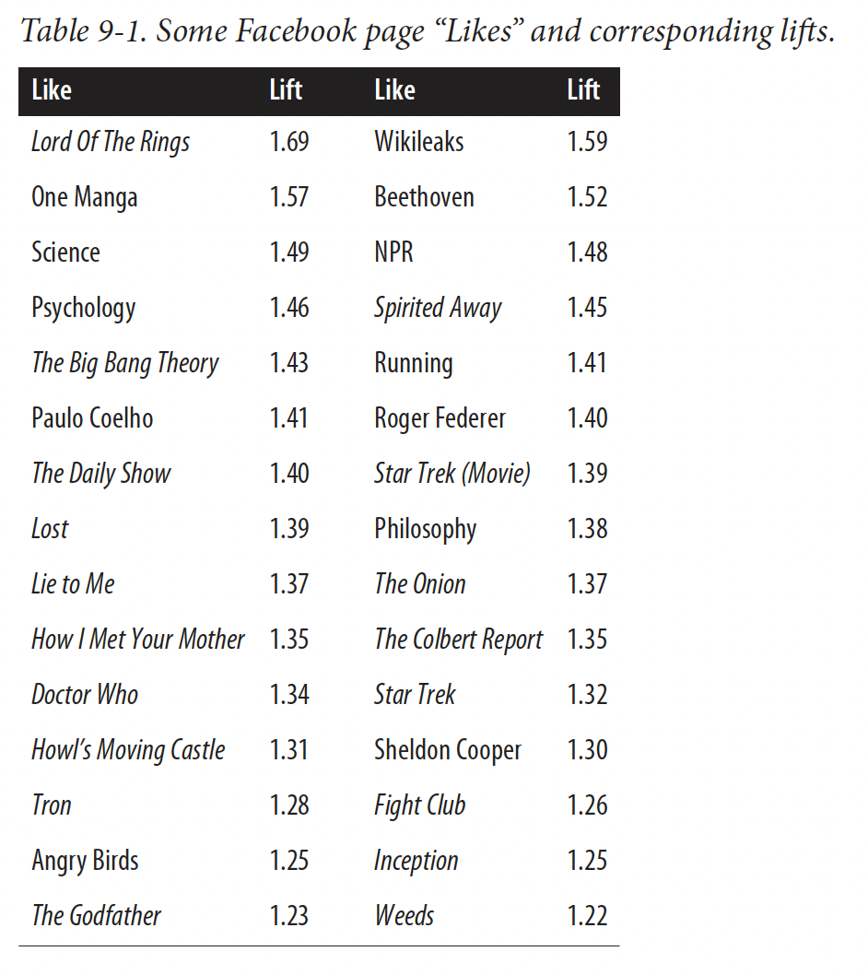
Naïve Bayes Example
DSB p 264
Evidence of lift from Facebook likes
Goal is to predict High IQ scores from various ”likes” on Facebook pages
“Likes” are like words
Binary
there are many of them
they are discrete
Kosinski, et al 2013

Slide 23
Representing Text for Data Science

Slide 24
Preparing Text for Modelling
Description | Loan Default
This loan request is to reduce credit card debt by receiving a more manageable finance charge and payment schedule than what I am currently paying on a monthly basis. I currently meet all my financial obligations without problems. This allows quicker debt reduction. | 0
This loan will lower my interest rate on about $7000 of debt by 2 percentage points! I have qualified for this great rate by having an outstanding credit score over the last 20 years. Thank you for helping to fund me.<br><br> This short term loan will allow me to lower my interest rate by 2 percentage points. I have qualified for a great rate due to my solid credit score, etc. Thank you for helping me to achieve my goals. | 0
To be financially stable within 3 years. Pay off all bills and concentrating on paying off my house within 10 years of my plan. | 0
To consildate credit card debt | 0
To consolidate bills for one monthly payment.<br><br> To pay off credit card debt and have one monthly payment.<br> | 0
To consolidate credit card bills and be debt free in 5 years<br> | 1
To consolidate credit card debt.<br><br> My loan is to consolidate credit card debt and simplify my payments,<br> | 1
To consolidate some credit cards and assist my son who is graduating from college relocate to the Washington DC area where he has accepted a full time job.<br> | 0
Notes:
How do we get this in a form ready for DS?
Feature engineering!!
Also remind them of the spam example…

Slide 25
Simplest method: Bag of Words
Each document is simply a bag of words (BoW)
Text: “This loan request is to reduce credit card debt by receiving a more manageable finance charge and payment schedule than what I am currently paying on a monthly basis. I currently meet all my financial obligations without problems. This allows quicker debt reduction.”
BAG:{without,what,to,this,this,than,schedule,request,reduction,reduce,receiving,quicker,problems,payment,paying,on,obligations,my,more,monthly,meet,manageable,loan,is,financial,finance,debt,debt,currently,currently,credit,charge,card,by,basis,and,am,allows,all,a,a,I,I}
This is known as tokenization: taking a document and reducing it to its terms
BoW is simple, convenient, but ignores:
Grammar
Word order
Sentence structure

Slide 26
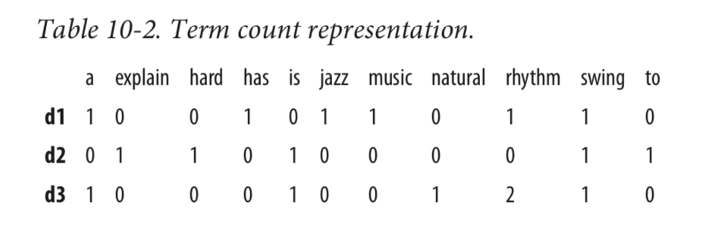
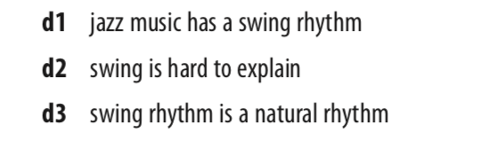
Expanding BoW: Term Frequency
From DSB: Chap 10:
This is a Term Frequency document – a count of the words in each document
TF(d,t) = # of times term t appears in document d

Slide 27
Text Mining: Processing
Language is notoriously messy!!! Looking at every word as its own entity might not make sense!
Not all words are important
Some words mean the same thing
Tenses
Long tail!
Spelling!
Phrases that might not make sense to break up : “data science” “double play”
…but we have to start somewhere …

Slide 28
Text Mining: Processing
Pre-processing steps for text:
Remove symbols and punctuation
Stop-word removal
(the, is, in, a, at, for, where, when)
But be careful - “not”, “very”, and ”the” can be important (e.g. “The Batman”)
Stemming – eliminate suffixes from words
“walking”,”walk”,”walked”,”walks” => “walk”
Synonym lookup and replacement
(“Travel”, “vacation”, “trip”, ”journey”) => “travel”
Remove rare words
Words that occur only once might overfit
Spell correction
Case correction
from nltk.corpus import stopwords
from nltk.stem import PorterStemmer
Embeddings: word2vec (advanced!)
pySpellChecker, JamSpell, textblob
String.lower()
All of these can be domain specific!

Slide 29
From unstructured to structured
After all of the counting and processing, we now have a structured Term Frequency (TF) data set for analysis
 | Database | SQL | Index | Regression | Likelihood | linear
D1 | 24 | 21 | 9 | 0 | 0 | 3
D2 | 32 | 10 | 5 | 0 | 3 | 0
D3 | 12 | 16 | 5 | 0 | 0 | 0
D4 | 6 | 7 | 2 | 0 | 0 | 0
D5 | 4 | 31 | 20 | 0 | 3 | 0
D6 | 2 | 0 | 0 | 18 | 7 | 6
D7 | 11 | 0 | 1 | 32 | 12 | 0
D8 | 3 | 0 | 0 | 22 | 4 | 4
D9 | 1 | 0 | 0 | 34 | 27 | 25
D10 | 6 | 0 | 0 | 17 | 4 | 23
documents
Can be used for supervised or unsupervised
Popular supervised methods for text include:
Support-vector machines (see previous notes)
Logistic regression (regularized for large feature space)
Naïve Bayes

Slide 30
Term-Frequency Table (TF)
Term-Frequency table
Often normalized to account for total words in each document
 | Database | SQL | Index | Regression | Likelihood | linear
D1 | 24 | 21 | 9 | 0 | 0 | 3
D2 | 32 | 10 | 5 | 0 | 3 | 0
D3 | 12 | 16 | 5 | 0 | 0 | 0
D4 | 6 | 7 | 2 | 0 | 0 | 0
D5 | 4 | 31 | 20 | 0 | 3 | 0
D6 | 2 | 0 | 0 | 18 | 7 | 6
D7 | 11 | 0 | 1 | 32 | 12 | 0
D8 | 3 | 0 | 0 | 22 | 4 | 4
D9 | 1 | 0 | 0 | 34 | 27 | 25
D10 | 6 | 0 | 0 | 17 | 4 | 23
To normalize, divide each number by the words in its own document
But how do we account for some terms being more important than others?
“Olivia” less important than “Rodrigo”
A term that is too common is not distinguishing, and therefore not useful for classification or clustering (stopwords, but others too)

Slide 31
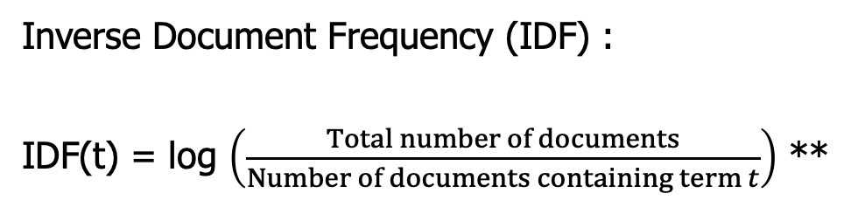
Inverse Document Frequency (IDF)
Concept:
The fewer documents a word appears in, the more significant it is when it does appear!
Inverse Document Frequency (IDF) :
IDF(t) = log $\left(\frac{Total number of documents}{Number of documents containing term t}\right)$ **
** Note: DSB book has a slightly different version of IDF
IDF is the boost a term gets for being rare
Rare terms have high IDF

Slide 32
Representing Text: TFIDF
A term is important for a given document if it has:
high term frequency (it appears a lot)
high IDF (it doesn’t appear in other documents as much)
A common way to represent text is to transform the original term document into a TFIDF version, where:
TFIDF(d,t) = TF(d,t) x IDF(t)

Slide 33
 | Database | SQL | Index | Regression | Likelihood | linear
D1 | 24 | 21 | 9 | 0 | 0 | 3
D2 | 32 | 10 | 5 | 0 | 3 | 0
D3 | 12 | 16 | 5 | 0 | 0 | 0
D4 | 6 | 7 | 2 | 0 | 0 | 0
D5 | 43 | 31 | 20 | 0 | 3 | 0
D6 | 2 | 0 | 0 | 18 | 7 | 6
D7 | 0 | 0 | 1 | 32 | 12 | 0
D8 | 3 | 0 | 0 | 22 | 4 | 4
D9 | 1 | 0 | 0 | 34 | 27 | 25
D10 | 6 | 0 | 0 | 17 | 4 | 23
 | Database | SQL | Index | Regression | Likelihood | linear
D1 | 2.53 | 14.6 | 4.6 | 0 | 0 | 0.53
D2 | 3.3 | 6.7 | 2.6 | 0 | 1.0 | 0
D3 | 1.3 | 11.1 | 2.6 | 0 | 0 | 0
D4 | 0.7 | 4.9 | 1.0 | 0 | 0 | 0
D5 | 4.5 | 21.5 | 10.2 | 0 | 1.0 | 0
D6 | 0.2 | 0 | 0 | 12.5 | 2.5 | 11.1
D7 | 0 | 0 | 0.5 | 22.2 | 4.3 | 0
D8 | 0.3 | 0 | 0 | 15.2 | 1.4 | 1.4
D9 | 0.1 | 0 | 0 | 23.56 | 9.6 | 17.3
D10 | 0.6 | 0 | 0 | 11.8 | 1.4 | 16.0
TFIDF version

Slide 34
NLP using TFIDF
Once you have a TFIDF matrix, you can now think about doing
Classification
Clustering
Similarties between documents
Typically done using cosine distance
Search!
Query becomes a vector of words, simply find the most similar documents!
Calculate the cosine distance between query text and the TFIDF matrix and you have yourself a search engine!
from sklearn.feature_extraction.text import TfidfVectorizer

Slide 35
Case Study – Mining News Stories
DSB – Chapter 10

Slide 36
Task: Stock Market Prediction
Goal: can we use the text of news stories to predict stock market movement?
If I could do that….
We will simplify things significantly:
It is unrealistic to tie long term stock behavior to a single article
We will look at one day
Too hard to predict the actual stock price
We will predict changes
Challenging to predict small changes (may be due to noise)
Look at large changes
Many factors impact stock prices at a macro level
Assume that only articles that name the stock are impacting the price

Slide 37
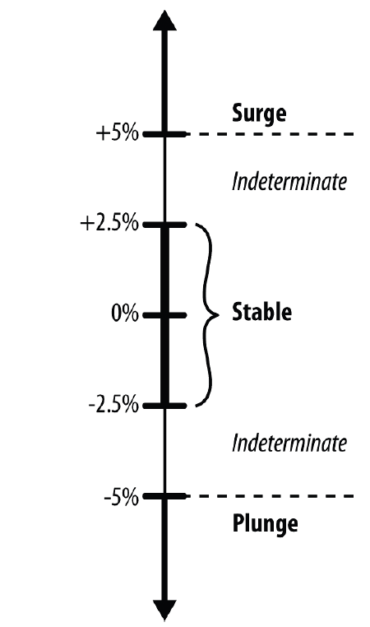
Simplifying further
Only predict changes of large magnitude … surge or plunge
Ignore changes of intermediate value
Simplifying even more, we will look at this as a two-class problem
Change(Surge/Plunge) vs no-change
Disclaimer: at this point we now have more of a fun data science exercise rather than an example we could take real action on…but…
we have to start somewhere..
Notes:
But you could think about how with more sophisticated methods you could refine this and maybe try and tease out some signal that could actually create an investment advantage…

Slide 38
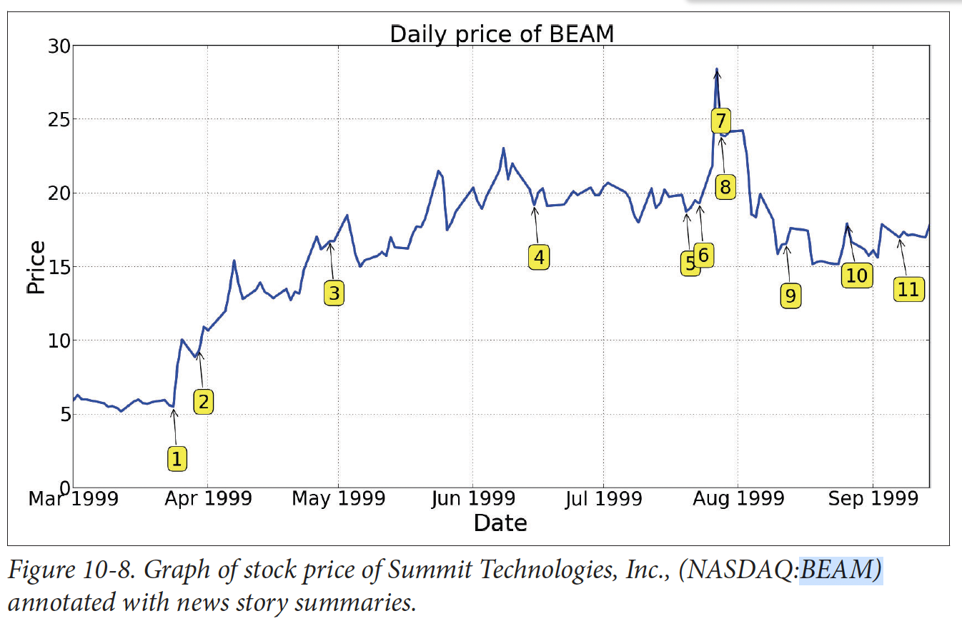
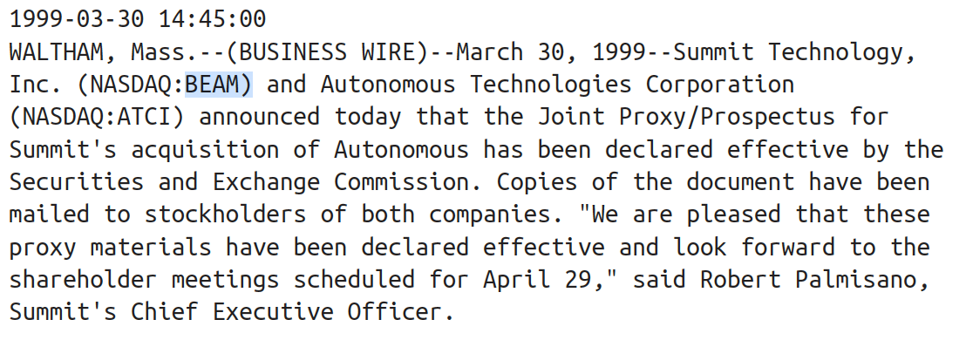
Data
Stock price changes with significant news articles tagged
A US FDA panel backs the use of a Summit Tech laster in LASIK procedures…
Actual text from news articles – with timestamp

Slide 39
Data Processing
For each stock, compute % daily change
Label as change/no-change
Final data had 75% no-change and 25% change
For each story, extract relevant stock tickers, and info
This is messy! Stories contain tables, charts, etc that need to be parsed
Multiple paragraphs in the same story about different stocks…
To avoid leakage: only use stories that occur outside of trading hours
Aka pre-market
(in reality would use much more sophisticated methods…)
Use Bag-of-words model
Case normalized, stemmed, stopword removal
Create “n-grams” of size one and two..

Slide 40
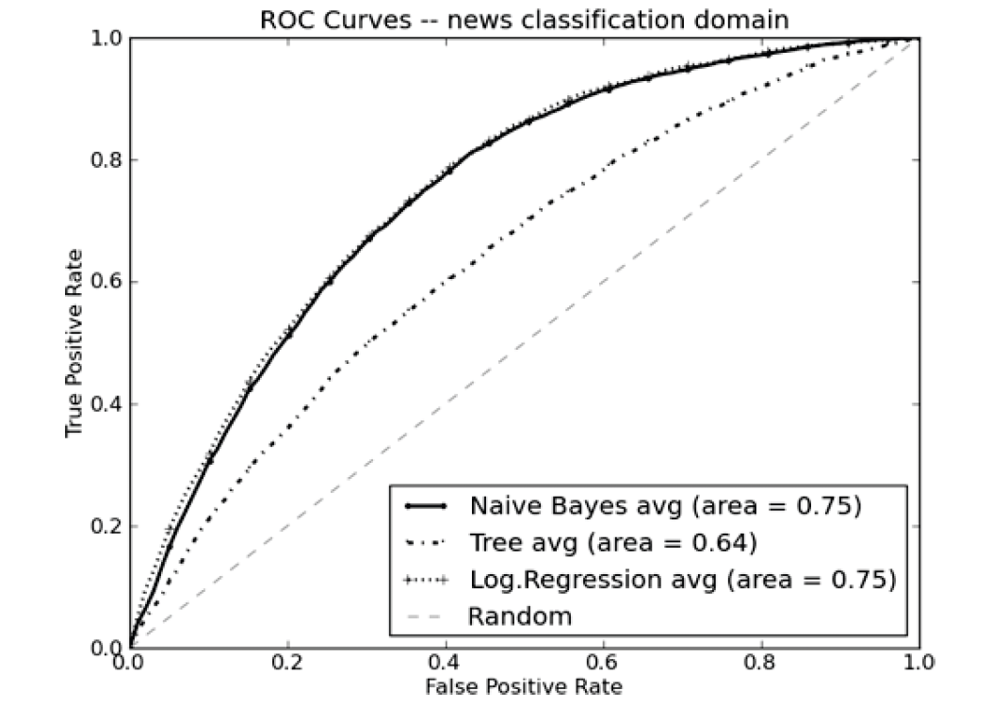
Results
There is some predictive power here – AUC > 0.5
Naïve Bayes and Logistic regression outperform Trees
No weird bulges or concavities showing strange model behavior
Logistic performs slightly better with the highest precision cases
So lets look at a lift curve…

Slide 41
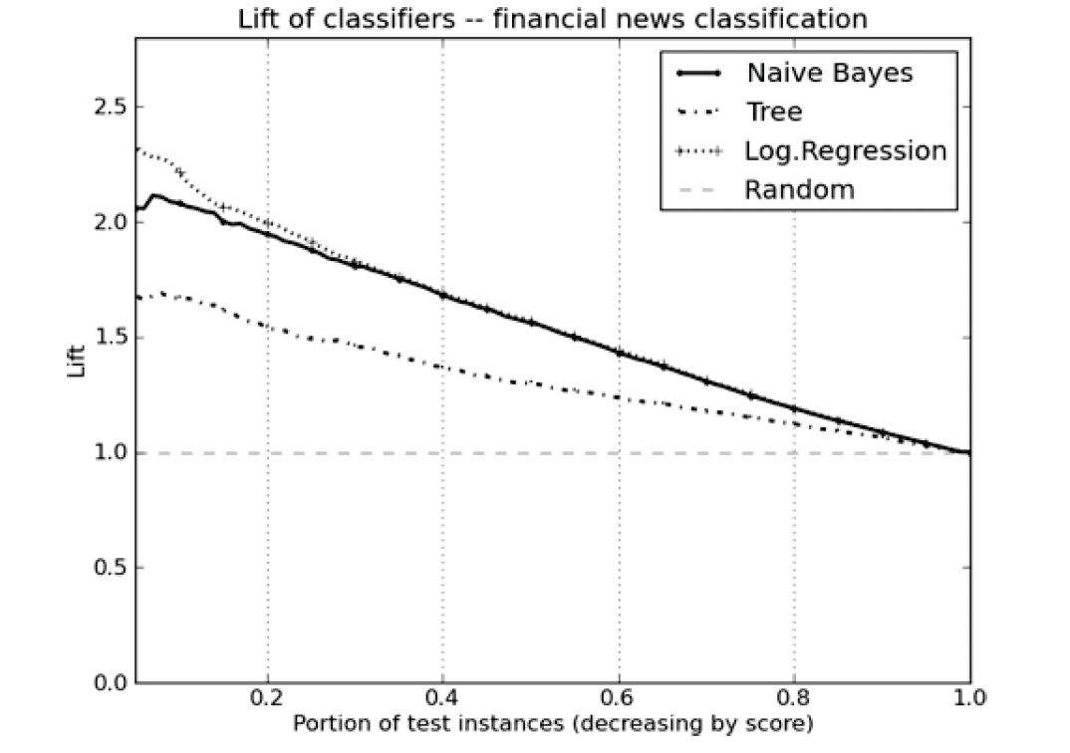
Results
Logistic regression tops out at just under 2.5x better than random
The top 10-20% of predicted articles were twice the baserate, or 50% change-inducing.

Slide 42
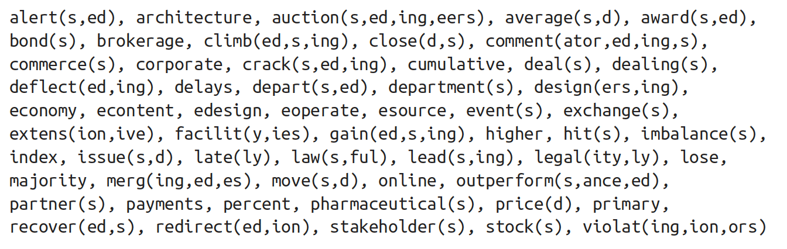
Significant words
These are the (single) words that were shown to have significant impact in the naïve bayes model…
Note: analysis was from 1999..

Slide 43
Module7_Text_NaiveBayes
mining_text.ipynb

Slide 44
NLP: Other Topics
import nltk
import spacy
Notes:
The stuff you just learned just scrathes the surface of NLP, now I will go rapid fire through some other topics…

Slide 45
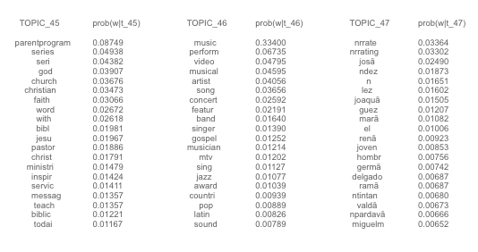
Topic Modelling – LSA/LDA, etc
“topic modelling” is a way of doing unsupervised learning on a set of documents (corpus)
Think of it as a clustering exercise, but using more involved linear algebra than k-means or hierarchical
Uses a technique similar to Principal Components to reduce the dimension of the data into “topics”
Typically starts with the TFIDF matrix
Extracts “topics” by finding clusters of words
Methods find “latent” topics
Latent Semantic Indexing (LSI)
Latent Dirichlet Analysis (LDA) – Bayesian! Probabilistic!
LDA applied to TV program data

Slide 46
Named Entity Recognition
Move us away from Bags of Words and toward understanding of the data
Knowing what are the proper nouns and names can go a long way to extracting meaning from text
Christopher Robin is alive and well. He is the same person that you read about in the book, Winnie the Pooh. As a boy, Chris lived in a pretty home called Cotchfield Farm. When Chris was three years old, his father wrote a poem about him. The poem was printed in a magazine for others to read. Mr. Robin then wrote a book

Slide 47
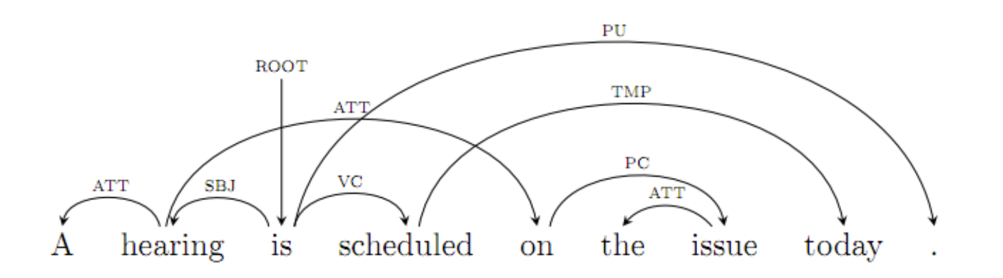
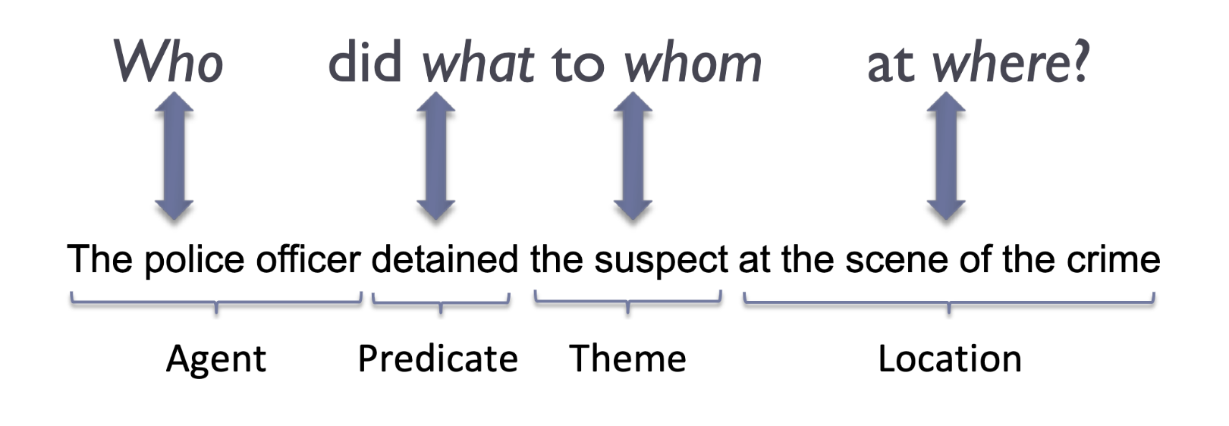
Part of Speech Detection
Natural Language parsing (PoS) attempts to deconstruct language into parts of speech to truly try to understand the meanings of sentences:
Import pos_tag from nltk
Courtesy https://ift6758.github.io/lectures/NLP_part1.pdf
Notes:
This requires a lot of specialized training data and a lot of computational power.

Slide 48
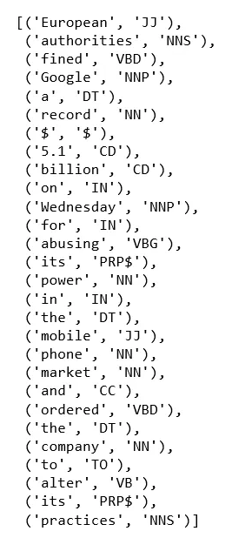
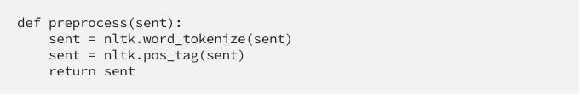

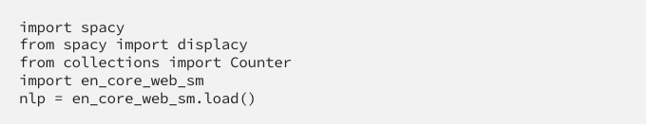
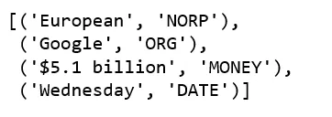
PoS / NER in python
https://towardsdatascience.com/named-entity-recognition-with-nltk-and-spacy-8c4a7d88e7da

Slide 49
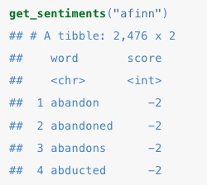
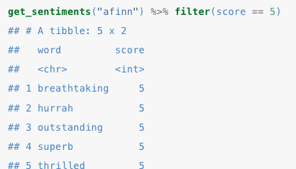
Sentiment Analysis
Many applications attempt to automatically identify text as positive or negative, based on the words used.
This is hard!
“this movie was not a total waste of time!”
“reading this book was so engrossing it destroyed my desire to do anything else”
Nonetheless, we can use:
Existing lists of good:bad words (e.g. AFINN)
Labeled corpuses from existing domains as training data
from nltk.corpus import movie_reviews as reviews
Notes:
Afinn is +5 to -5
-5 is REALLY bad

Slide 50
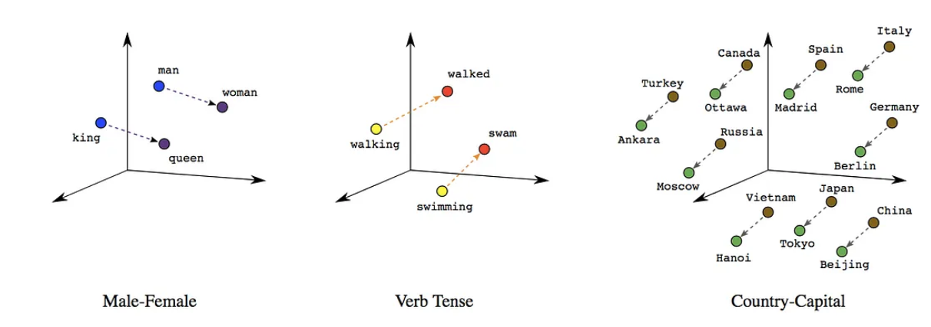
Embeddings
Embeddings are a fairly recent approach to NLP
Words are “embedded” into a multidimensional space, so that they are near other words of similar meaning or common context:
Embeddings allow a phrase like “queen bey” to be associated with the named entity “Beyonce Knowles” and can be used in all of the NLP tasks we have already discussed
Embeddings turn words into locations in a multi-dimensional space so that similar words are together (happy ⬄ joyful) but words can also have multiple meanings (BMW ⬄ Jaguar ⬄ leopard). Removes the need for synonym lookup.
Embeddings also allow words to have different meanings and helps identify similarities
Important tools : pre-trained word embeddings you can use:
Word2vec
gloVe
BERT
Depending on the domain, might want to make your own embedding
Notes:
. Magic of embeddings is that they are not trained by knowing the definition of words, they simply are trained on gobs of text.
BERT can look at the entire sentence and not just adjacent words – it is one of the foundations of modern generative AI tools.

